Slide 1
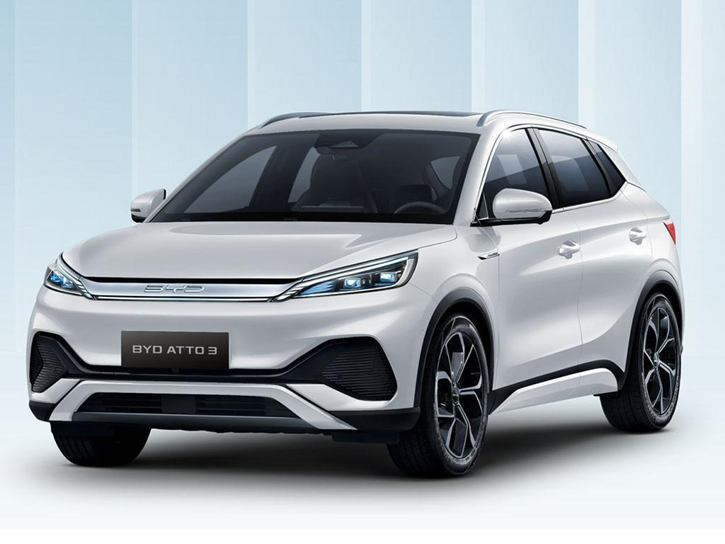
CAR SALE ANALYSIS

Slide 2
PREVIEW
Car id
Date
Customer name
Gender
Dealer name
Company name
Model of the car
Transmission; Manual and Automatic
Engine and colour,
Body style
Region

Slide 3
INTRODUCTION
This presentation analysis gives data and insights gathered from the analysis of the automotive market trends, sales performance and the impact of the company marketing campaign.
These findings will provide a comprehensive view of the company performance, market trends, key findings, and the effectiveness of the strategies in driving sales.

Slide 8
CONCLUSION
The sale analysis has shown positive trends in sales from January 2022 to December 2023.
The company's campaign has proven to be effective in driving sales growth and reflects a positive response from consumers.
It's important the company capitalizes on this success and continue to refine marketing strategies and exploring further avenue for growth.

Slide 9
THANK YOU

